Slide 1
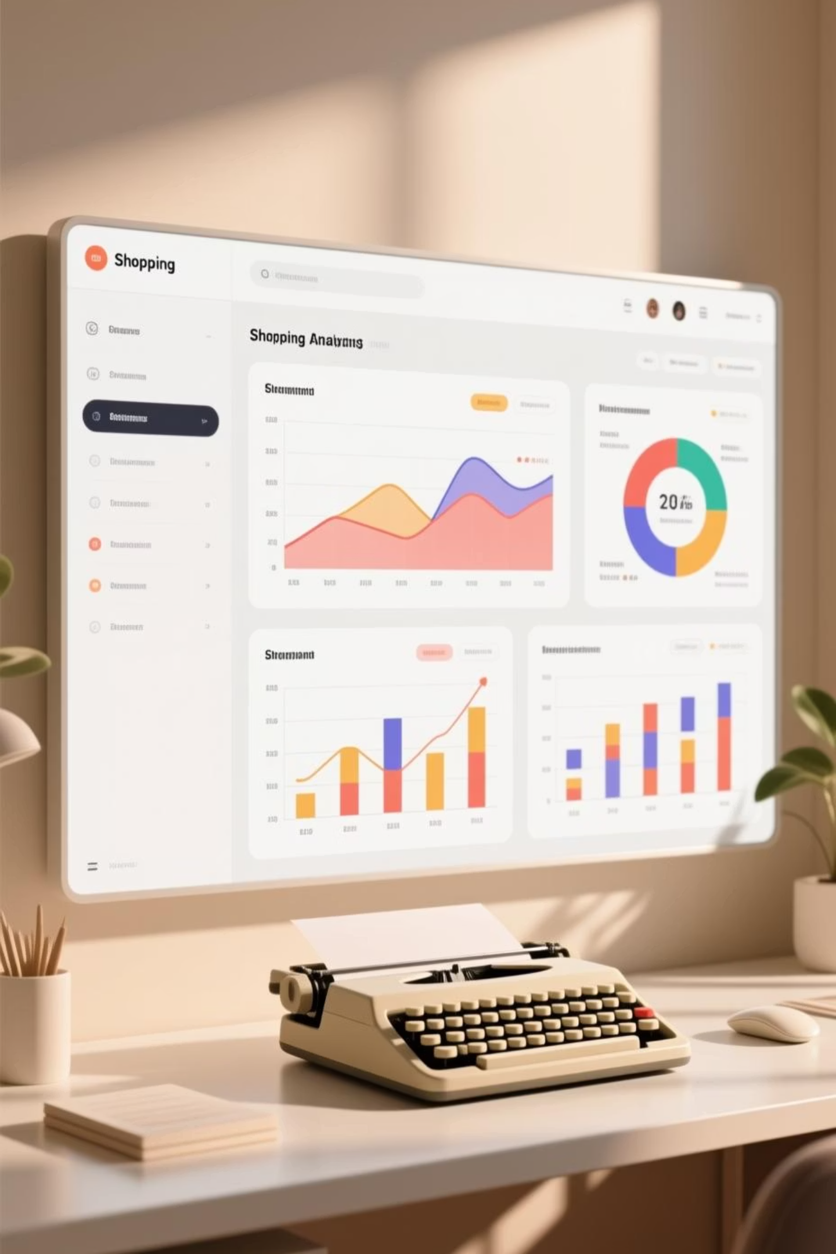
Customer Shopping Behavior Analysis
Analyzing 3,900 customer transactions to uncover insights into spending patterns, customer segments, and product preferences that drive strategic business decisions.

Slide 2
Dataset Overview
3,900
18
37
Total Purchases
Data Columns
Missing Values
Transactions analyzed across various product categories
Comprehensive features covering demographics and behavior
Only in Review Rating column, handled through imputation
Customer Demographics
Purchase Details
Age, Gender, Location
Item, Category, Amount
Subscription Status
Season, Size, Color
Shopping Behavior
Service Metrics
Discount Applied
Frequency of Purchases
Promo Code Used
Review Rating
Previous Purchases
Shipping Type

Slide 3

Data Preparation & Python Analysis
01
Data Loading & Exploration
Imported dataset using pandas, performed initial exploration with df.info() and .describe() for summary statistics
02
Data Cleaning
Checked for null values and imputed missing Review Rating values using median rating of each product category
03
Feature Engineering
Created age_group column by binning customer ages and purchase_frequency_days column from purchase data
04
Database Integration
Connected Python to PostgreSQL and loaded cleaned DataFrame for SQL analysis

Slide 4
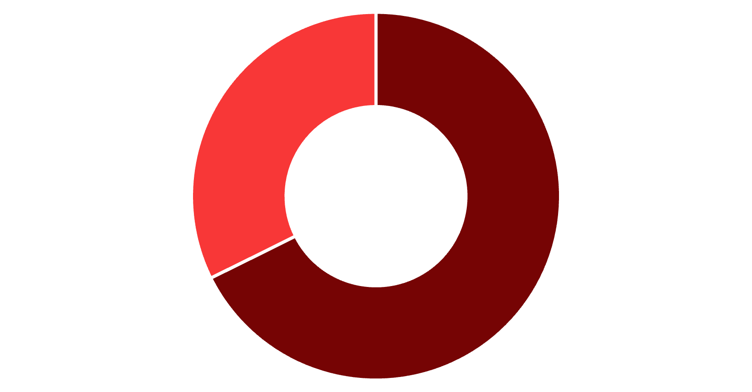
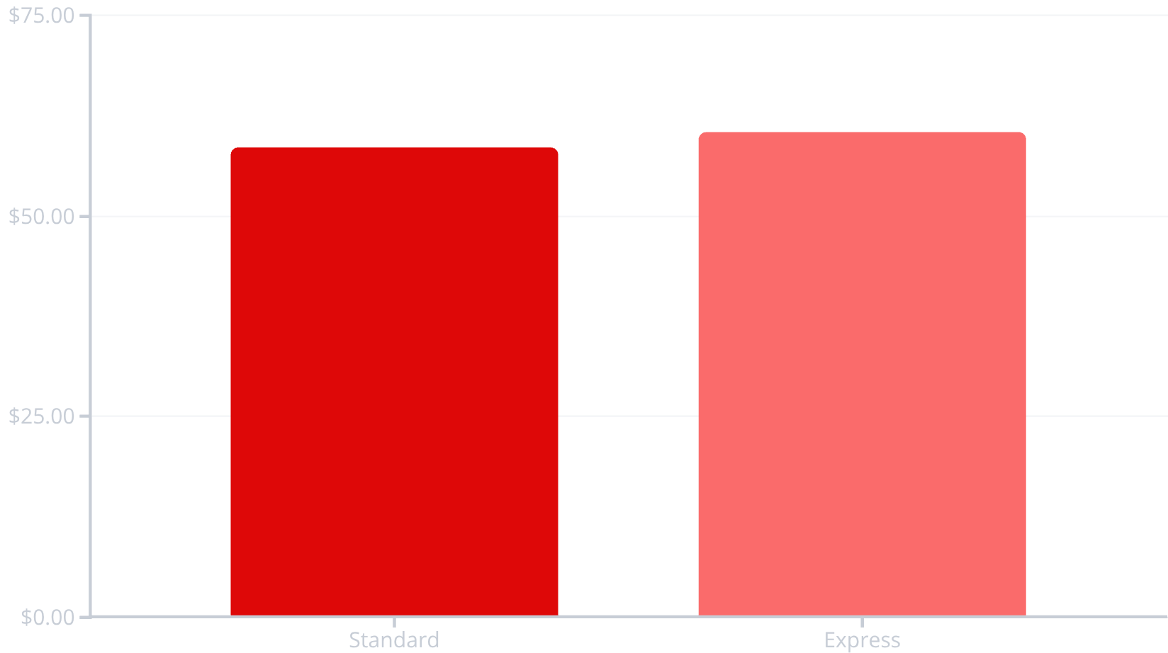
Revenue Insights by Gender & Shipping
Revenue by Gender
Shipping Type Comparison
Male
Female
Male customers generate more than double the revenue of female customers, representing a significant opportunity for targeted marketing.
Express shipping customers spend slightly more on average, indicating higher-value customer segment.

Slide 5

Customer Segmentation Analysis
Loyal Customers
Returning Customers
3,116 customers
701 customers
The largest segment representing repeat buyers with strong brand affinity
Mid-tier segment showing potential for loyalty program conversion
New Customers
83 customers
Smallest segment requiring onboarding and engagement strategies
Customer segmentation based on purchase history reveals that 80% of customers are already loyal, presenting opportunities to convert returning customers into the loyal segment through targeted programs.

Slide 6


Subscription & Discount Behavior
Subscribers vs Non-Subscribers
High-Spending Discount Users
839 customers used discounts but still spent above the average purchase amount, demonstrating that discounts don't necessarily reduce transaction value.
27%
Subscription Rate
1,053 of 3,900 customers
Subscribers and non-subscribers show similar average spend ($59.49 vs $59.87), but non-subscribers generate higher total revenue due to larger volume.
Repeat Buyers & Subscriptions
Among customers with more than 5 purchases: 958 are subscribers while 2,518 are not, indicating significant untapped subscription potential.

Slide 7
Product Performance Insights
Top-Rated: Gloves
Sandals
Boots
Average rating: 3.86
Average rating: 3.84
Average rating: 3.82
Top Products by Category
Accessories
Clothing
Footwear
Jewelry (171 orders)
Blouse (171 orders)
Sandals (160 orders)
Sunglasses (161)
Pants (171)
Shoes (150)
Belt (161)
Shirt (169)
Sneakers (145)

Slide 8
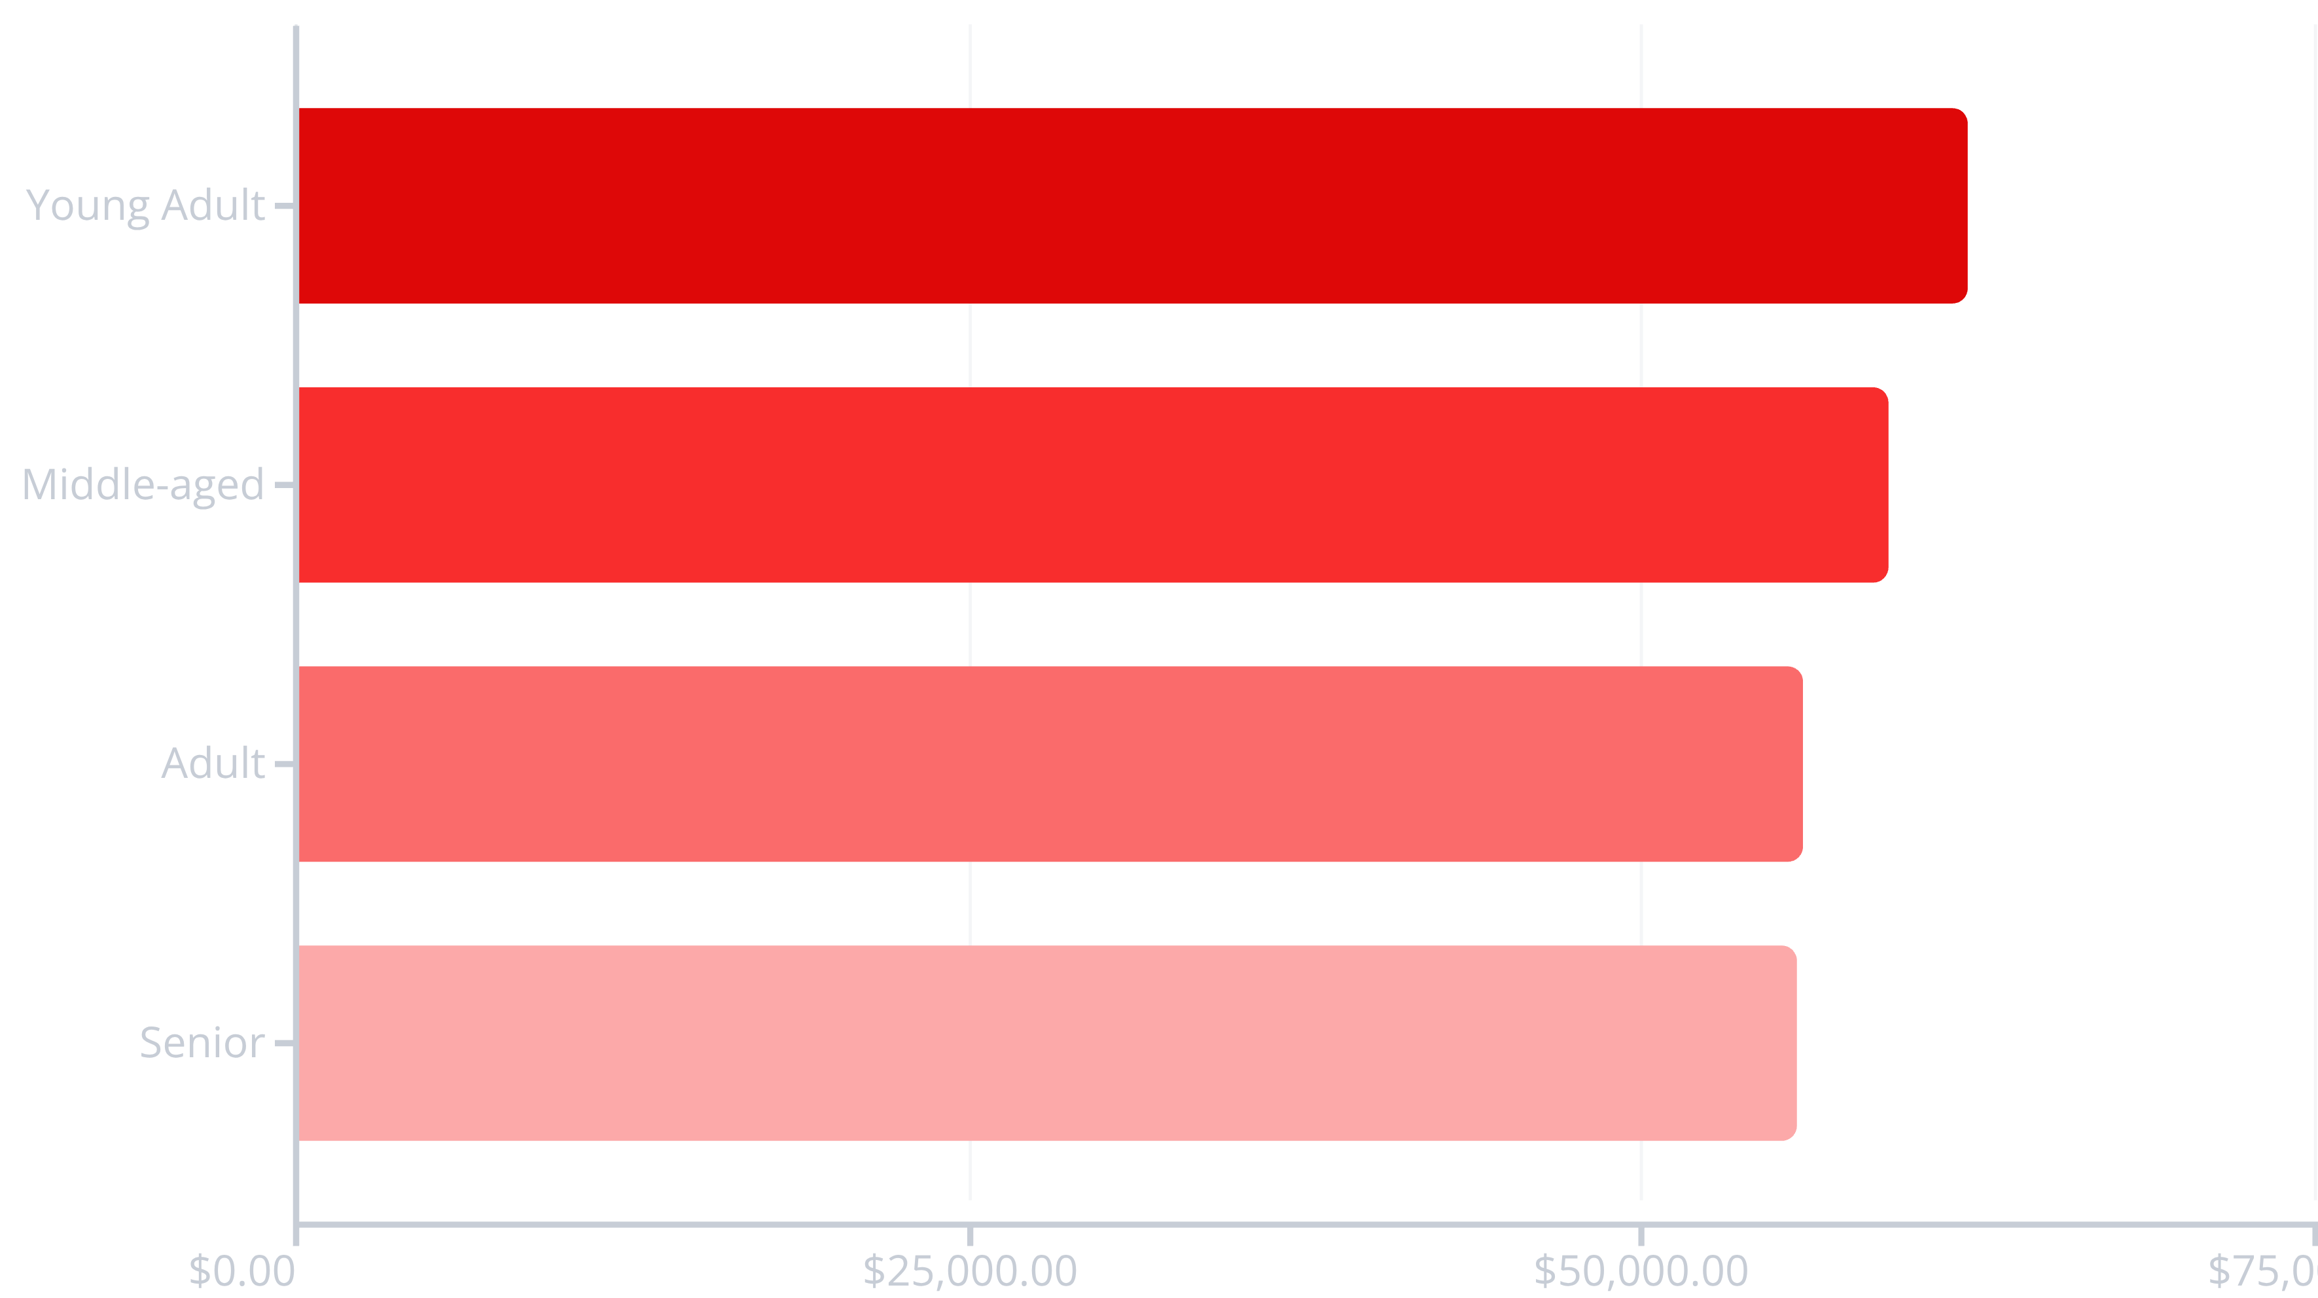
Revenue Distribution by Age Group
Young adults generate the highest revenue at $62,143, followed closely by middle-aged customers at $59,197. Revenue distribution is relatively balanced across age groups, suggesting broad market appeal.

Slide 9



Strategic Business Recommendations
Boost Subscriptions
Customer Loyalty Programs
Review Discount Policy
Promote exclusive benefits for subscribers, especially targeting the 2,518 repeat buyers who aren't yet subscribed
Reward repeat buyers to move returning customers into the loyal segment
Balance sales boosts with margin control, focusing on products with highest discount dependency
Product Positioning
Targeted Marketing
Highlight top-rated products like gloves and sandals in marketing campaigns
Focus efforts on high-revenue age groups and express-shipping users

